Slide 1
HOSPITAL MANAGEMENT SYSTEM
SET – 1
INF 6210: Database Management Database Design
Instructor: Prof. Mutsalklisana

Slide 2
Contents
EER Diagram
Create Database
Drop Database
Use Database
Safe Delete
Table Creation

Slide 3
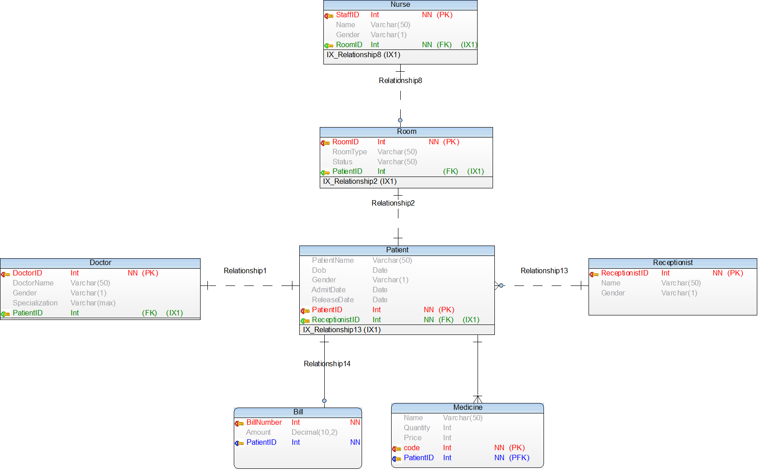
EER Diagram

Slide 4
Create Database
CREATE command is used for creating database
DROP command is use for dropping a database

Slide 5
Use Database
USE command is used for using a particular database
SET command is used for safe delete

Slide 6
Table Creation
Model has seven tables in the model. They are:
Patient
Doctor
Receptionist
Nurse
Room
Medicine
Bill

Slide 7
Table Creation
CREATE command is used for creating table
In practice, they are usually created in the implementation phase later on in the development process
However, we create them here to explain some concepts
One table is created for each table shown in the relational schema

Slide 8
Table Creation
Each attribute is defined, taking the data type and length from the domain definitions
For example, the attribute Patient_Name can be defined as a VARCHAR (variable character) type with length 25
By specifying NOT NULL, each attribute can be constrained from being assigned a null value
The primary key for each table is specified using the PRIMARY KEY clause at the end of each table definition

Slide 9
PRIMARY KEY
A primary key is a special relational database table column (or combination of columns) designated to uniquely identify all table records.
A primary key’s main features are: – It must contain a unique value for each row of data. – It cannot contain null values.
A primary key is either an existing table column or a column that is specifically generated by the database according to a defined sequence.
On some RDBMS a primary key automatically generates a clustered table index by default.

Slide 10
REFERENTIAL INTEGRITY CONSTRAINTS
Referential integrity constraints are easily defined using the graphical schema
An arrow originates from each foreign key and points to the related primary key in the associated relation
In SQL, a FOREIGN KEY REFERENCES statement corresponds to one of these arrows
The foreign key Patient_ID references the primary key of Patient, which is also Patient_ID
Although here the foreign and primary keys have the same name, this need not be the case – but the foreign and primary keys must be from the same domain

Slide 11
PATIENT Table Create

Slide 12
DOCTOR Table

Slide 13
RECEPTIONIST Table

Slide 14
BILL Table

Slide 15
ROOM Table

Slide 16
NURSE Table

Slide 17
MEDICINE Table

Slide 18
THANK YOU

